Slide 1
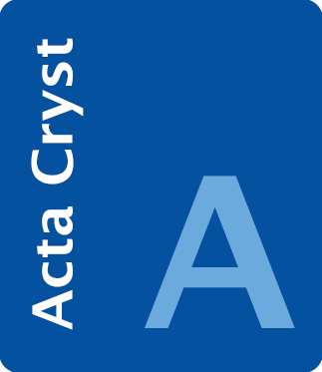
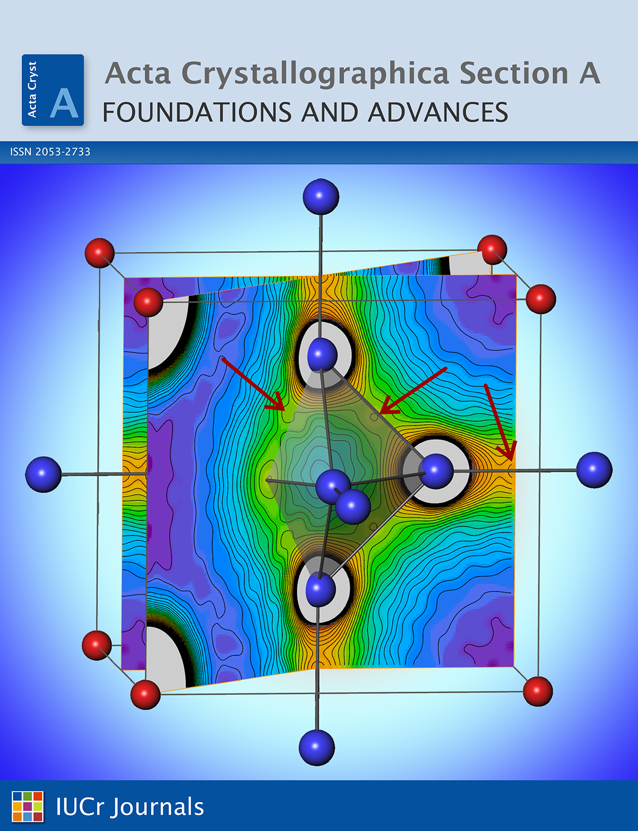
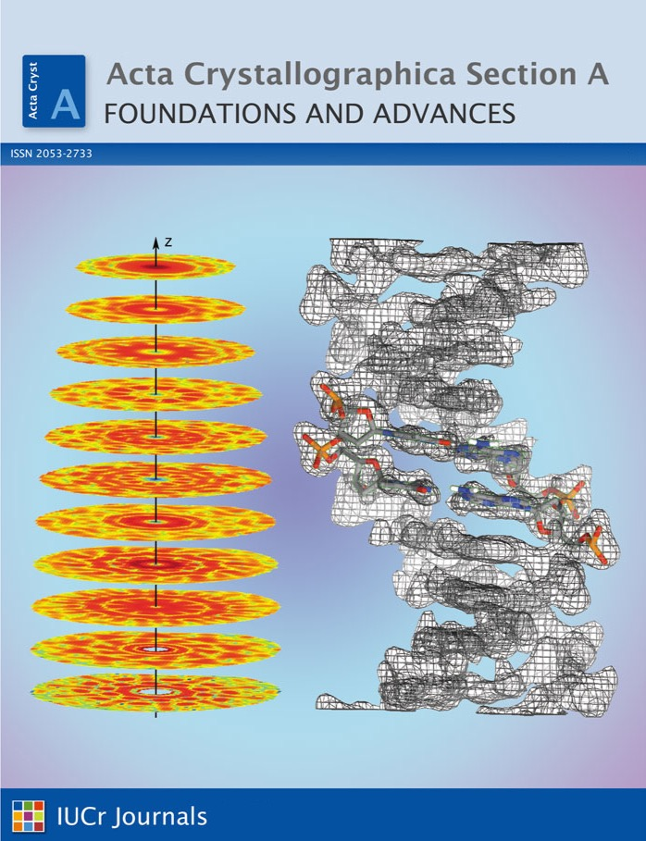
journals.iucr.org/a/ @ActaCrystA
Acta Crystallographica Section A
Foundations and Advances

