Slide 1
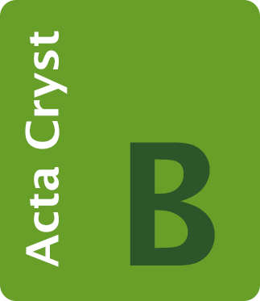
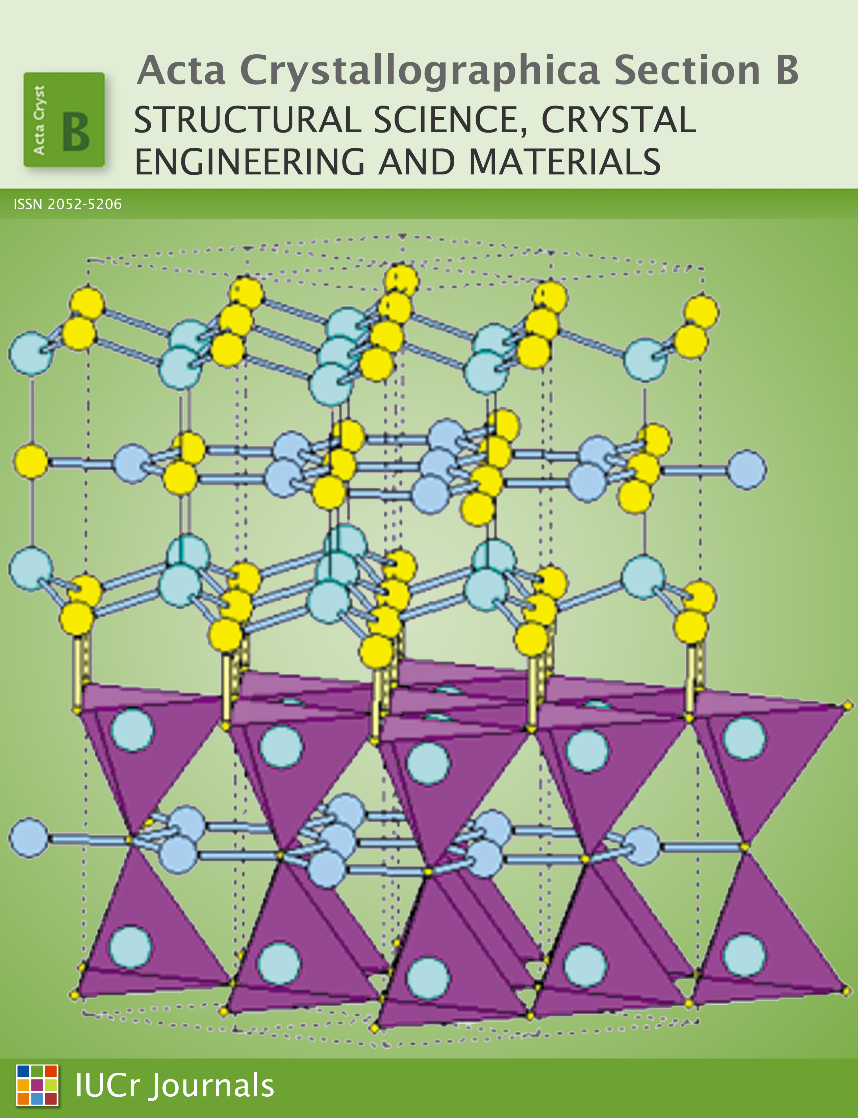
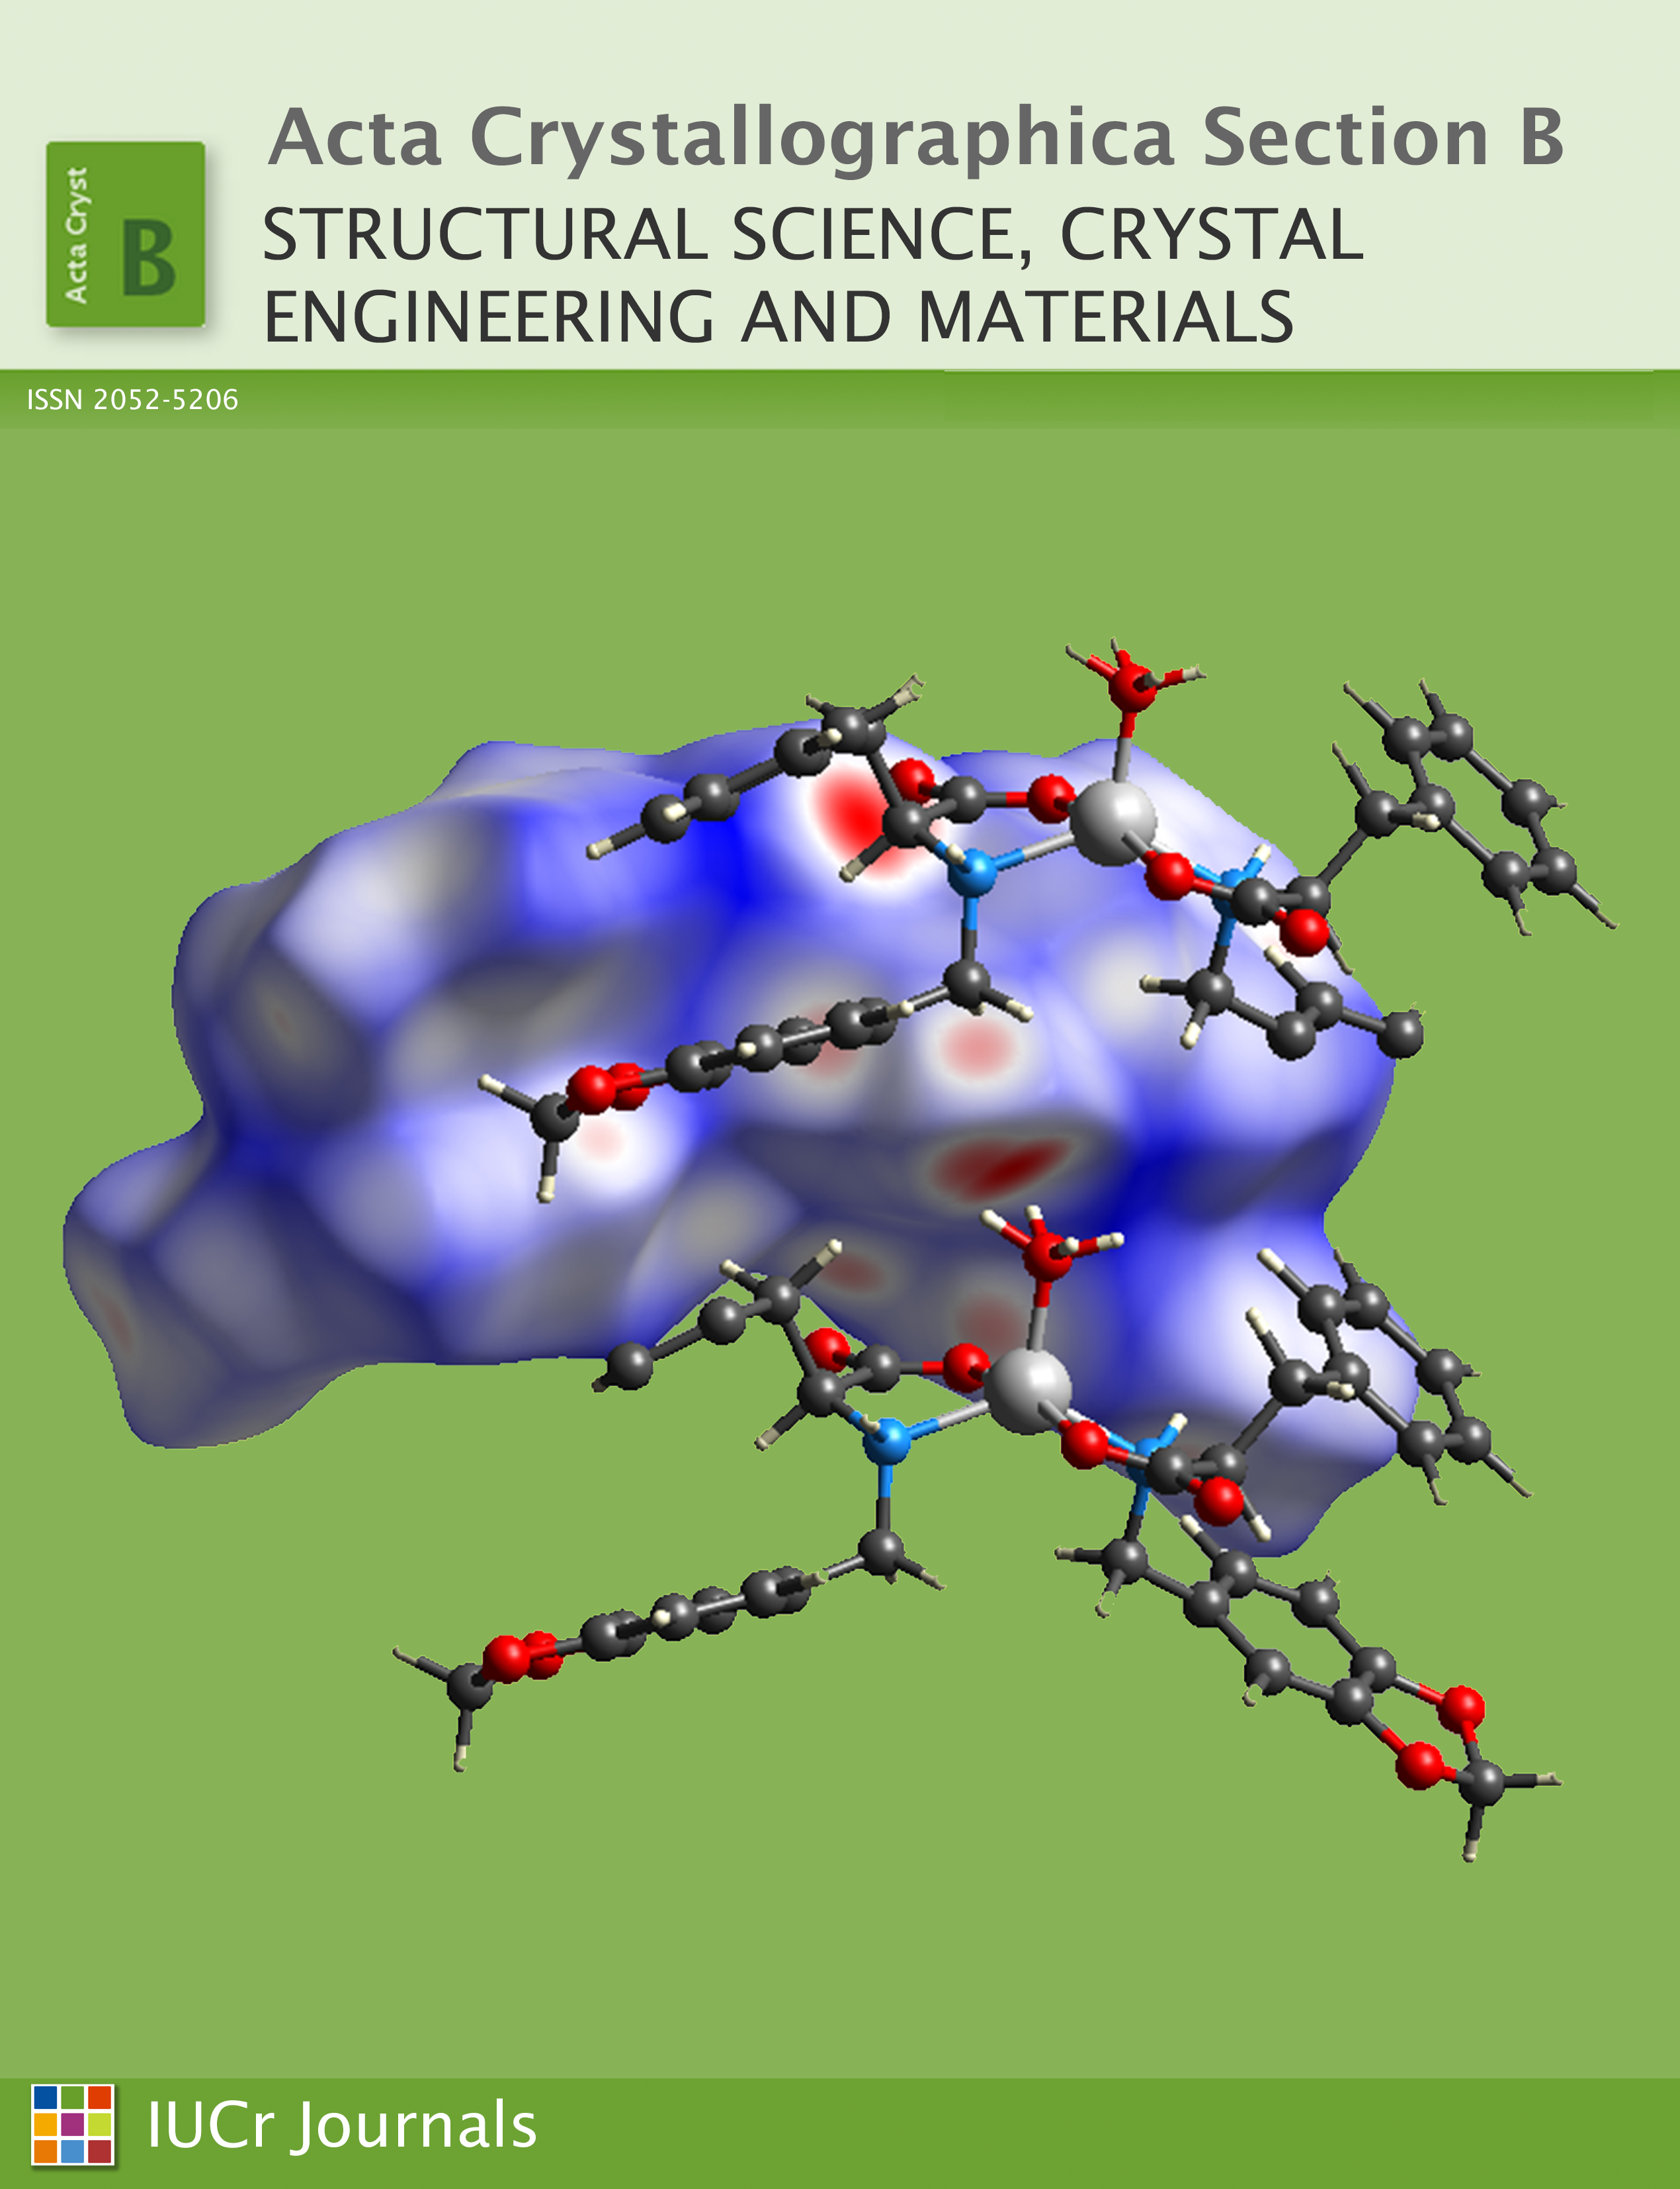
journals.iucr.org/b/ @ActaCrystB
Acta Crystallographica Section B
Structural Science, Crystal Engineering and Materials

